Slide 1
Organizational Psychology
Unit III

Slide 2
In this unit…
Motivation and performance: overview of motivation theories.
Attitudes, Emotion and Work - Moods - Emotions - Attitudes and Behavior
Stress and Worker Well Being: Problem of stress - Theories of Stress - Reducing and managing stress - Violence at work - Fairness and diversity at workplace
Leadership – Concept - Traditional theories of leadership - New approaches to Leadership - Current trends in Positive Psychology at workplace.

Slide 3
Motivation
Motivation and performance
Motivation concerns the conditions responsible for variations in intensity, persistence, quality, and direction of ongoing behavior (Vinacke, 1962).
The earliest I-O theories of motivation were anchored in the notions of instincts, and inborn tendency that is thought to direct behavior., principally driven by psychodynamic theories of personality, most notably Freud’s approach.
The term “instinct” was gradually replaced with terms such as “need,” “motive,” and “drive” (Viteles, 1953). In 1943, Maslow proposed a need theory that replaced an infinite number of “instincts” with a specific set of needs. Like instincts, needs were thought to be inborn and universally present in humans. Because a great deal of motivational research was being conducted on animals (studying hunger and thirst), drives were the nonhuman equivalent of motives and needs.

Slide 4
At about the time that Maslow’s need theory was becoming widely known, the behaviorism of B. F. Skinner (1938) was also becoming a powerful force. The behaviorist approach placed the emphasis for behavior directly on the environment rather than on any internal needs or instincts. The disagreements between the behaviorists and non-behaviorists became known as the nature-versus-nurture controversy. Other, broader approaches also allowed for the influence of the environment, but in a much less mechanical way than suggested by the behaviorists.
An example of this broader approach was Lewin’s field theory, which proposed that various forces in the psychological environment interacted and combined to yield a final course of action (Lewin, 1935, 1938). Each force was thought to have a “valence” (much like the valences of chemical elements) that attracted or repelled the individual. The application of Lewin’s approach in industry became known as group dynamics.

Slide 5
A very basic model for considering the role of motivation in performance is the following: Performance = (Motivation X Ability) - Situational Constraints.
It is important to note the multiplication sign in this formula. This sign means that if motivation is equal to zero, then ability will not matter since anything times zero equals zero. Similarly, it means that even modest increases in ability can be magnified by motivation.
Work–life balance is an area of research that investigates whether the satisfaction that one experiences at work is in part affected by the satisfaction that one experiences in non-work and vice versa, particularly to the extent that one environment has demands that conflict with the other.
Personality and motivation are interconnected. Locus of control (LOC) refers to the extent to which an individual views events as resulting from his or her own actions (an internal LOC) or from outside causes (an external LOC). People with an internal LOC believe that they can control their environments; people with an external LOC believe that they are at the mercy of external environments with little ability to influence outcomes.

Slide 6
Motivation theories
Weiner (1991, 1992) suggested that the best way to gain an understanding of the wide variation in motivational theories, as well as of the evolution of motivational thinking, is through the use of metaphors. A metaphor is intended to illuminate an obscure or difficult concept by example.Weiner suggests that all motivational theories can be described by one of two metaphors: the person as machine and the person as scientist.
Person as machine is a metaphor that suggests that people’s behaviors/actions are reflexive and involuntary and are performed without conscious awareness.
Person as scientist is a metaphor that suggests that people are active information gatherers and analysts who seek knowledge and understanding as a way of mastering their environment.
Person as judge is a metaphor in which an individual seeks information about the extent to which the person and others are perceived as responsible for positive and negative events. The person looks for evidence of intention in the actions of others and considers those intentions in choosing a personal course of action.

Slide 7
An Internal Mechanical Theory: Maslow’s Need Theory
Abraham Maslow (1943) proposed that all humans have a basic set of needs and that these needs express themselves over the life-span of the individual as internal “pushes” or drives.
Maslow’s need theory was more a theory of human development than one of work motivation.
Generally, the theory proposed that when we are young, we are more concerned with our physical well-being. As we become more secure in our physical world, we then begin to emphasize social needs. Finally, when our social foundation seems secure, we then concentrate on developing our abilities and capacities to their fullest. Thus, Maslow proposed five different sets of needs and arranged them hierarchically. In his model, the lower needs take precedence over the higher needs. Physiological needs were the lowest and self-actualization needs the highest among the five categories.

Slide 8
1. Physiological needs. These are what learning theories generally refer to as basic needs or drives and are satisfied by such things as food, water, and sleep.
2. Security needs. This category refers to the need an individual has to produce a secure environment—one free of threats to continued existence.
3. Love or social needs. These needs are associated with interpersonal factors. They refer to an individual’s desire to be accepted by others.
4. Esteem needs. These needs are associated with being respected for accomplishments or capabilities.
5. Self-actualization needs. These needs refer to the desire on the part of an individual to develop his or her capacities to the fullest. In Maslow’s theory, few people ever completely satisfy this need. Instead, the individual would always be seeking to grow and develop. Some examples of fully self-actualized individuals might be Martin Luther King, Jr., Gandhi, or Mother Theresa (although even they might have claimed that they were not finished “growing”).

Slide 9
An External Mechanical Theory: Reinforcement Theory
Reinforcement theory proposes that behavior depends on three simple elements: stimulus, response, and reward. Proposed that if a response in the presence of a particular stimulus is rewarded (i.e., reinforced), that response is likely to occur again in the presence of that stimulus.
When a reward depends on a response, it is called a contingent reward (i.e., the reward is contingent on the response). Contingent reward or reinforcement is a central proposition of the behaviorist approach. A second important proposition has to do with the schedule of reward or reinforcement. Rewards can be given continuously (every time a correct response occurs, a reward is presented) or intermittently (only a portion of correct responses are rewarded). Ferster and Skinner (1957) discovered that intermittent rewards actually produced higher levels of performance than continuous rewards.

Slide 10
Person-as-Scientist Theories
The first formal work motivation theory to suggest that people weighed options before choosing among them was the path–goal theory of Georgopoulos, Mahoney, and Jones (1957). They reasoned that if a worker saw high productivity as a path to the goal of desired rewards or personal goals (e.g., a pay increase or promotion, or increased power, prestige, or responsibility), that worker would likely be a high producer. Conversely, if low productivity was seen as a path to desired rewards (e.g., less stress, more time with family, approval of co-workers), that worker would likely be a low producer.
This theory was a simple one in conception, but it marked a dramatic shift in thinking about motivation: a shift from the person as machine to the person as scientist. The new approach was presented in a more elegant way by Vroom (1964) in a theory that has come to be known as VIE (valence, instrumentality, and expectancy) theory.

Slide 11
Valence is the strength of a person’s preference for a particular outcome.
Instrumentality is the perceived relationship between performance and the attainment of a certain outcome.
Expectancy is an individual’s belief that a particular behavior (e.g., effort, hard work) will lead to higher performance.
Vroom reasoned that psychological objects in an environment also have attracting and repelling forces. For most people, money would be attracting, and uninteresting work would be repelling. For the most part, this element of Vroom’s theory was not much different from the earlier person-as-machine approaches. It was a simple recognition that people have needs or desires.
If a manager wanted to apply Vroom’s theory, he or she would concentrate on three things:
1. Motivate employees by offering outcomes that have high valence.
2. Clarify instrumentalities by letting employees know that high performance is associated with positive outcomes.
3. Clarify expectancies by making it clear to employees that hard work will lead to higher performance.

Slide 12
Another popular person-as-scientist theory was proposed by Adams (1965). As in Vroom’s VIE theory, Adams proposed that people are calculators, but in a somewhat different way than proposed by Vroom. In 1957, Festinger proposed dissonance theory.
Dissonance theory suggested by Festinger, observed that tension exists when individuals hold “dissonant cognitions” (incompatible thoughts). This approach assumes that individuals always seek some sense of “balance” (i.e., absence of tension) and that they will direct their behavior toward reducing the tension resulting from dissonant cognitions.
Equity theory is a motivational theory developed by Adams (1965) that suggested that individuals look at their world in terms of comparative inputs and outcomes. Individuals compare their inputs and outcomes with others (e.g., peers, co-workers) by developing an input/outcome ratio.
Comparison to others—A co-worker or idealized other person to whom the individual compares himself or herself in determining perceived equity.
The outcome/input ratio is the ratio that results when employees compare their inputs and outcomes to those of others (e.g., peers, co-workers) to determine if they are being treated equitably.

Slide 13
Attitudes, emotions and work
Emotions experienced at work affect both work and non-work behavior. Similarly, non-work related emotions affect both work and non-work behavior. Understanding emotions at work is no simple task. Not only do we experience both work and non-work stimuli but we also have a range of different reactions, ranging from attitudes to emotions to moods.
Attitudes are relatively stable feelings or beliefs that are directed toward specific persons, groups, ideas, jobs, or other objects.
Job satisfaction is the positive attitude or emotional state resulting from the appraisal of one’s job or job experience.
In the Hawthorne study, the improved attitudes of workers toward supervisors as a result of the increased attention appeared, in turn, to be responsible for the increase in productivity. This led to the introduction of a new term into the literature of social psychology: the Hawthorne effect, meaning a change in behavior or attitudes that was the simple result of increased attention.
Herzberg and colleagues found a connection between satisfaction and other work behaviors, which led them to introduce one of the first modern theories of job satisfaction, the two-factor theory. They proposed that extrinsic factors satisfy hygiene needs and intrinsic factors satisfy motivator needs.

Slide 14
Measurement of job satisfaction
There are two different measurement issues concerning job satisfaction. The first is the distinction between satisfaction with specific aspects of work (often called facet satisfaction) versus a measure of overall satisfaction. The second is the use of questionnaires to measure satisfaction.
Overall satisfaction is the overall assessment of job satisfaction that results either from mathematically combining scores based on satisfaction with specific important aspects of work or a single overall evaluative rating of the job.
Facet satisfaction Information related to specific facets or elements of job satisfaction.
There are some instances in which an overall score will work just fine (e.g., comparing one plant or division of an organization to another) and other instances in which facet information might be more useful (e.g., trying to identify which aspects of the work environment might play a central role in recruiting new employees).

Slide 15
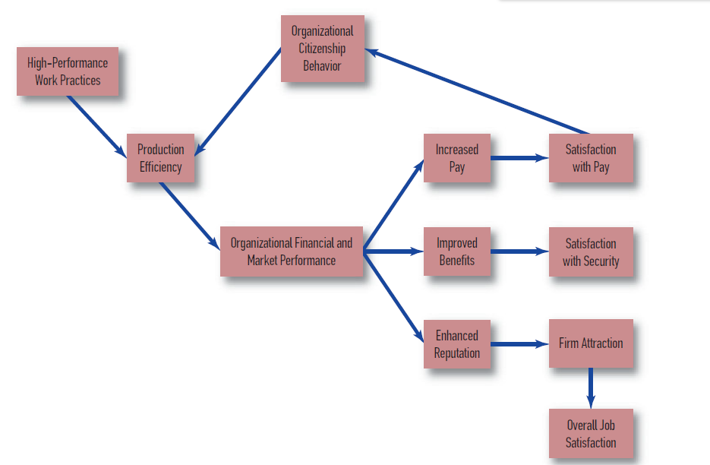
Relationship between High-Performance Work Practices and Job Satisfaction

Slide 16
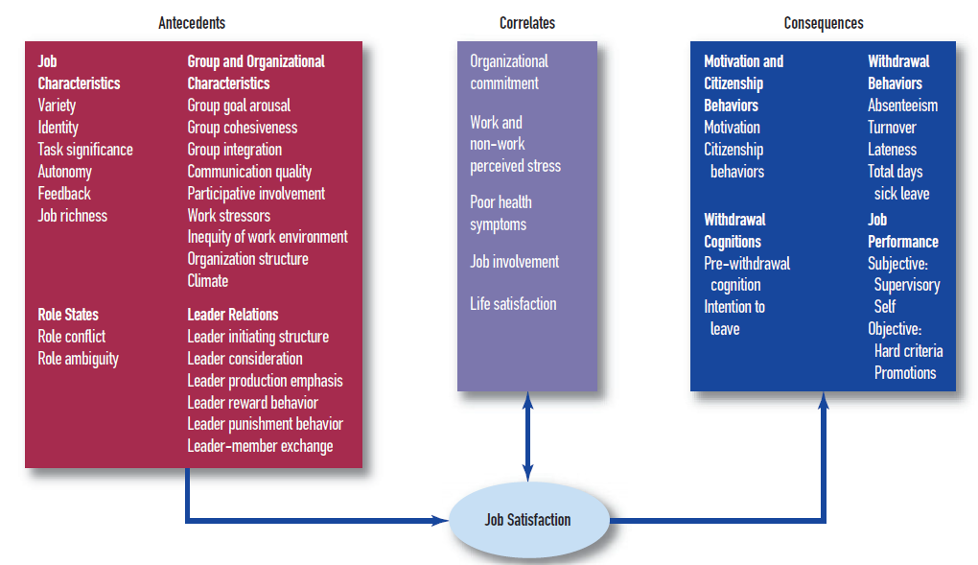
Classification of Presumed Antecedents, Correlates, and Consequences of Job Satisfaction

Slide 17
Satisfaction questionnaire
Job Descriptive Index (JDI) is one of the most extensively researched and documented job satisfaction instruments; assesses satisfaction with five distinct areas: the work itself, supervision, people, pay, and promotion. The disadvantages of the JDI are that the questionnaire is lengthy (it has 72 items) and that the broad category of “work” does not provide much information about issues such as creativity, independence, variety, or other aspects of the work itself.
An alternative to the JDI is the Minnesota Satisfaction Questionnaire (MSQ), a commonly used job satisfaction instrument that assesses particular aspects of work (e.g., achievement, ability utilization) as well as scores for extrinsic satisfaction and intrinsic satisfaction.
Intrinsic satisfaction is the satisfaction that derives from aspects central, or intrinsic, to the job itself, such as responsibility.
Extrinsic satisfaction is the satisfaction that derives from aspects extrinsic, or external, to job tasks, such as pay or benefits.

Slide 18
The concept of commitment is often associated with both attitudes and emotions. Commitment to a relationship, an organization, a goal, or even an occupation involves emotional attachment, as well as evaluations of whether current circumstances are what one expected or might expect in the future.
Commitment is a psychological and emotional attachment an individual feels to a relationship, an organization, a goal, or an occupation.
Porter, Steers, Mowday, and Boulian (1974) proposed that organizational commitment includes three elements: (1) acceptance and belief in an organization’s values, (2) a willingness to exert effort on behalf of the organization to help meet its goals, and (3) a strong desire to remain in the organization.
Meyer and Allen (1997) suggested that organizational commitment could be based on any one of three elements: (1) an emotional attachment to an organization, or affective commitment; (2) an element representing the perceived cost of leaving the organization, or continuance commitment; and (3) an element representing an obligation to remain in the organization, or normative commitment.

Slide 19
Several different scales have been used to assess organizational commitment. The most commonly used scale is Meyer, Allen, and Smith’s (1993) Organizational Commitment Questionnaire (OCQ), which contains six items for each of the three commitment dimensions.
They found that the three foundations for organizational commitment could also be applied to the notion of occupational commitment, a commitment to a particular occupational field; includes affective, continuance, and normative commitment.
Job embeddedness is the many and varied types of commitment that individuals feel toward co-workers, teams, organizations, and careers.
Even though the concept of commitment has an affective component, its general thrust is more cognitive than emotional. The commitment concept profits from a cognitive orientation because it is commonly used to explain why people remain with or leave an organization or occupation. To be sure, these decisions can be emotional (or worse, irrational), but because they are usually life-altering, there is often a cognitive basis to those decisions.
The concept of organizational identification (OID) has been proposed as a way of dealing with the much more basic and emotional aspects of organizational membership.

Slide 20
Organizational identification (OID) is the process whereby individuals derive a feeling of pride and esteem from their association with an organization. Individuals may also take pains to distance themselves from the organization for which they work—this would be called organizational disidentification.
A relatively new construct that is receiving a lot of attention from I-O psychologists is employee engagement, which is defined as a positive work-related state of mind that includes high levels of energy, enthusiasm, and identification with one’s work (Bakker & Leiter, 2010; Schaufeli & Salanova, 2007). Discussions and debates are still ongoing about how to measure employee engagement and how it relates to other important work attitudes (e.g., Macey & Schneider, 2008; Newman & Harrison, 2008).

Slide 21
Mood, emotions, attitude and behaviour
Büssing and his colleagues (Büssing, 2002; Büssing & Bissels, 1998) have proposed four different forms of work satisfaction and two forms of work dissatisfaction namely, progressive work satisfaction, stabilized work satisfaction, resigned work satisfaction, pseudo work satisfaction, constructive work dissatisfaction and fixated work dissatisfaction. These six forms are the result of the interaction of three basic variables: (1) the discrepancy between what a person desires from work and what he or she actually gets, (2) changes in goal or aspiration levels as a result of work experience, and (3) the extent to which a person engages in coping or problem-solving behavior.
It is evident from different research that moods and emotions are associated with work behaviors, including organizational citizenship behavior, performance judgments, creative problem solving, and withdrawal behaviors such as absenteeism and turnover (Barsade & Gibson, 2007).

Slide 22
Mood is a generalized state of feeling not identified with a particular stimulus and not sufficiently intense to interrupt ongoing thought processes.
Emotion is an effect or feeling, often experienced and displayed in reaction to an event or thought and accompanied by physiological changes in various systems of the body.
Affect circumplex is a figure in which opposite emotions appear directly across from each other in the circle.
Process emotion is the reaction that results from consideration of the tasks one is currently doing.
Prospective emotion is the reaction that results from a consideration of the tasks one anticipates doing.
Retrospective emotion it the reaction that results from a consideration of the tasks one has already completed.

Slide 23

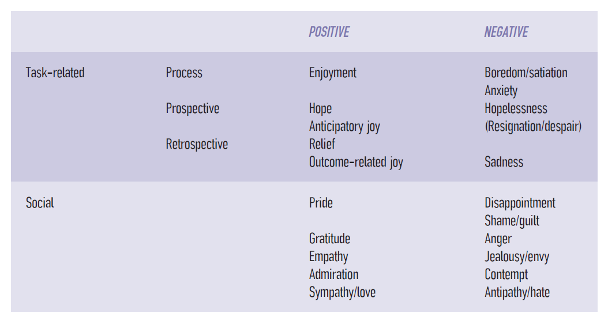

Slide 24
Brief and Weiss (2002) were enthusiastic about research on the role of dispositions on job satisfaction. Two dispositions that have received a great deal of attention are negative affectivity (NA) and positive affectivity (PA).
Negative affectivity (NA) - Disposition wherein individuals are prone to experience a diverse array of negative mood states (e.g., anxiety, depression, hostility, and guilt).
Positive affectivity (PA) - Disposition in which individuals are prone to describe themselves as cheerful, enthusiastic, confident, active, and energetic.
Job satisfaction and affectivity have reciprocal influences on each other to the extent that positive people tend to be more satisfied with their jobs, and this satisfaction in turn helps individuals maintain a positive level of general life satisfaction, further enhancing their positive affectivity. It is also likely that disposition makes negative information about work more salient to the high-NA person and positive information more salient to the high-PA person—the proverbial difference between the person who sees the glass as half full and the person who sees it as half empty

Slide 25
The Time Course of Emotional Experience
In contrast with cognitive ability or personality, which are relatively stable, emotional experience can be a roller coaster. We can be excited when we arrive at work, angry by 10:00 a.m., disengaged by lunch, pleased by 2:00 a.m., and annoyed when we leave at the end of the day. Not only does one emotion replace another, but the strength of a single emotion can grow and diminish regardless of any competing emotions. Weak positive emotion (e.g., the pleasure from getting an unexpected small gift) may disappear in less than 20 minutes (Isen, Clark, & Schwartz, 1976). The variability of emotional experience has recently emerged as an important issue in understanding the effects of moods and emotions on both work and non-work behavior.
Some of the research findings suggest that
● The effect of negative environmental events on mood is five times stronger than the effect of positive events, even though positive events are reported more frequently than negative events (Miner, Glomb, & Hulin, 2005).
● Positive experiences at work reduce end-of-day feelings of fatigue (Zohar, Tzischinski, & Epstein, 2003) and increase general feelings of well-being (Harris, Daniels, & Briner, 2003).

Slide 26
● Counterproductive work behavior is much more likely to result from momentary (state) hostility or experiences of injustice than from stable personality characteristics; the effects of these momentary experiences are then exaggerated if the individual is also chronically (trait) hostile (Judge, Scott, & Ilies, 2006).
● In samples of German and Swiss public service employees who had high stress levels after work, opportunities to recuperate and unwind were particularly important. Specifically, researchers found that activities involving relaxation, mastery experiences (e.g., engaging in sports and exercise), and high sleep quality were related to positive affect in the morning before the employees returned to work (Sonnentag, Binnewies, & Mojza, 2008).
● Insomnia at night contributes to negative emotions (hostility and fatigue) at work on subsequent days. These negative emotions subsequently relate to reports of lower job satisfaction (Scott & Judge, 2006).
● Employees experience more positive emotions when interacting with co-workers and customers than when interacting with their supervisors (Bono, Foldes, Vinson, & Muros, 2007).

Slide 27
Genetics and Job Satisfaction
Another intriguing research hypothesis regarding job satisfaction and work-related emotional experiences is that emotional experience may be influenced by genetics. Staw, Bell, and Clausen (1986) reported that positive affectivity (e.g., individuals described as cheerful) or negative affectivity (e.g., individuals described as irritable or depressed) as measured in adolescence predicted job satisfaction as much as 50 years later. Thus, dispositions might be considerably more stable than implied by the term “mood.” Irritable adolescents were dissatisfied workers in adulthood, and happy adolescents were happy workers in adulthood. For our present purposes, we will simply conclude that there is good reason to suspect that at least dispositions (if not more specific job attitudes) have a genetic element to them, but considerably more research will be required before anyone can speak with confidence on the possible connection.
A number of I-O researchers have proposed that individuals make core self-evaluations of their circumstances and that these core self-evaluations affect both job and life satisfaction (Judge & Bono, 2001; Judge, Bono, & Locke, 2000; Wu & Griffin, 2011). The elements of core self-evaluations include self-esteem, self-efficacy, locus of control, and the absence of neuroticism (see Figure 9.8). This combination of attributes can also be thought of as positive self-regard (Judge, Bono, Erez, & Locke, 2005).

Slide 28
Grandey (2000) emphasized another concept in emotions: For many jobs, the regulation of emotional expression may be critical. This has been labeled emotional labor, regulation of one’s emotions to meet job or organizational demands; can be achieved through surface acting and deep acting.
Surface acting consists of managing or faking one’s expressions or emotions. For example, waiters in fine restaurants report that they commonly display pleasant emotions while simultaneously hiding feelings of anger and frustration toward rude customers.
Deep acting consists of managing one’s feelings, including trying to actually change one’s emotional state to match the emotions required by the job. For example, a waitress might try to imagine herself in a difficult customer’s situation to try to feel empathy for the customer and better understand the customer’s point of view.of managing one’s feelings, including trying to actually change one’s emotional state to match the emotions required by the job. For example, a waitress might try to imagine herself in a difficult customer’s situation to try to feel empathy for the customer and better understand the customer’s point of view.

Slide 29
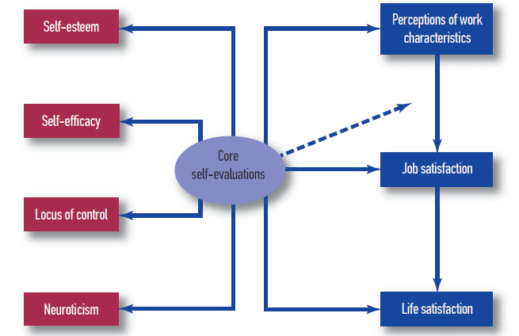

Slide 30
One of the earliest and most enduring research questions related to job satisfaction is the hypothesis that dissatisfaction leads to withdrawal from the workplace. Hanisch and Hulin (1990) further suggest that there are really two different types of withdrawal behaviors: work withdrawal and job withdrawal. Work withdrawal includes lateness and absenteeism and represents an attempt by the individual to withdraw from work but still maintain ties to the organization and the work role. Job withdrawal, on the other hand, includes intentions to quit or retire and represents an individual’s willingness to sever ties to the organization and the work role.
Withdrawal behaviors include absenteeism, turnover, tardiness, and retirement may be different manifestations of a larger construct called withdrawal.
Progression hypothesis is a progression of withdrawal behaviors that start with tardiness, increase to absenteeism, and eventually result in a decision to quit or retire.

Slide 31
Work–Family Balance
Work–family balance is the area of research that investigates whether the satisfaction that one experiences at work is in part affected by the satisfaction that one experiences in non-work, and vice versa.
Most research and theory related to work–family balance actually concentrates on the effects of a lack of balance. These effects are often discussed in terms of the stress created by conflicting demands between work and non-work activities.
The challenges of work–family balance are being felt across many different nations and cultures. One of the most substantial influences on achieving a work–family balance is an organizational culture that specifically supports family values.
In assessing work–life imbalance, it has also been popular to point to multiple roles— particularly for employed women, who are traditionally caregivers in the home environment— as the culprit (Williams, Suls, Alliger, Learner, & Wan, 1991).

Slide 32
Wentworth (2002) pointed to the electronically enhanced communications environment in which most people work, which includes e-mail, laptops, and smartphones. One is never out of touch, which may be a boon to sales representatives eager to strike while the client is hot, and to medical professionals whose timely advice may save a life, but a burden to many other workers who find no opportunity to “turn off” their thoughts about the job. As Wentworth noted, the idea that a job is 24/7 does not even raise an eyebrow today; on the contrary, it is seen as a positive value indicating commitment to a job, organization, and career. It suggests that a worker who needs to be constantly reachable must be important to the organization. But it also suggests that work is more important than non-work.
The challenges of work–family balance are being felt across many different nations and cultures.

Slide 33
One can imagine a continuum with an exclusive non-work focus on one end, an exclusive work focus on the other end, and a balance between work and non-work in the middle. The challenge for any individual is to design both work and non-work environments in a way that will increase the likelihood of a balance. And this balance will be disturbed at various times on both sides of the equation (Judge & Ilies, 2004).
The design of work is jointly shared by a worker and an organization. The design of non-work is jointly shared by a worker and others with whom the worker interacts in the non-work environment. Balance will be jointly determined by those two forces. Perhaps the most important element in achieving that balance, however, is for all parties—in both work and non-work environments—to acknowledge the legitimacy and importance of the other parties.

Slide 34
Stress and worker wellbeing
Stress is a known contributor to colds and flu, digestive difficulties, headaches, insomnia, stroke, and other physiological problems, as well as to impaired psychological well-being (e.g., anxiety, depression, burnout) and counterproductive behaviors such as absenteeism and drug abuse (Cooper, Dewe, & O’Driscoll, 2001; Krantz & McCeney, 2002). I-O psychologists devote a great deal of effort to identifying the causes of work stress, to understanding how it relates to health, and to developing strategies for reducing or managing it.
A comprehensive framework for studying work stress was developed by Kahn and Byosiere (1992). Their model presents several important factors in the stress process, including (1) work stressors (task and role stressors), (2) moderators of the stress process (individual differences, social support), and (3) strains, or the consequences of stress (burnout, heart disease)

Slide 35
Two of the first stress pioneers were Walter Cannon and Hans Selye. Cannon was a physiologist who studied animal and human reactions to dangerous situations. He noted that animals and humans have an adaptive response to stressful situations in which they choose to either fight or attempt to escape. Cannon (1929) called this response the fight-or-flight reaction, and he is often credited with being the first to use the term “stress.”
Often referred to as the “father of stress,” Hans Selye (1956, 1976) defined stress as the non-specific response of the human body to any demand made on it. He was the first to distinguish between good stress (eustress) and bad stress (distress). Selye noted that eustress provides challenges that motivate individuals to work hard and meet their goals. Alternatively, distress results from stressful situations that persist over time and produces negative health outcomes.

Slide 36
Selye observed that the response sequences to almost any disease or trauma (e.g., poisoning, injury, psychological stress) are nearly identical. He named the progression the general adaptation syndrome (GAS) and divided it into three stages. First, in the alarm reaction stage, the body mobilizes resources to cope with added stress. In this stage, the heart rate increases and stress hormones, such as adrenaline, noradrenaline, epinephrine, and cortisol, are released. Second, in the resistance stage, the body copes with the original source of stress, but resistance to other stressors is lowered. Third, in the exhaustion stage, overall resistance drops and adverse consequences, including burnout, severe illness, and even death, can result unless stress is reduced.
Cannon’s (1929) fight-or-flight reaction comes in response to the type of stress that occurs suddenly and is likely to last only a short time—episodic, or acute, stress— whereas Selye’s (1956) general adaptation syndrome tracks the body’s response to stress over a longer period of time. Although workplace stress can be episodic, as in the case of an on-the-job accident or a confrontation with an irate customer, it is chronic stress that is more common in work settings and more damaging to the body and mind.

Slide 37
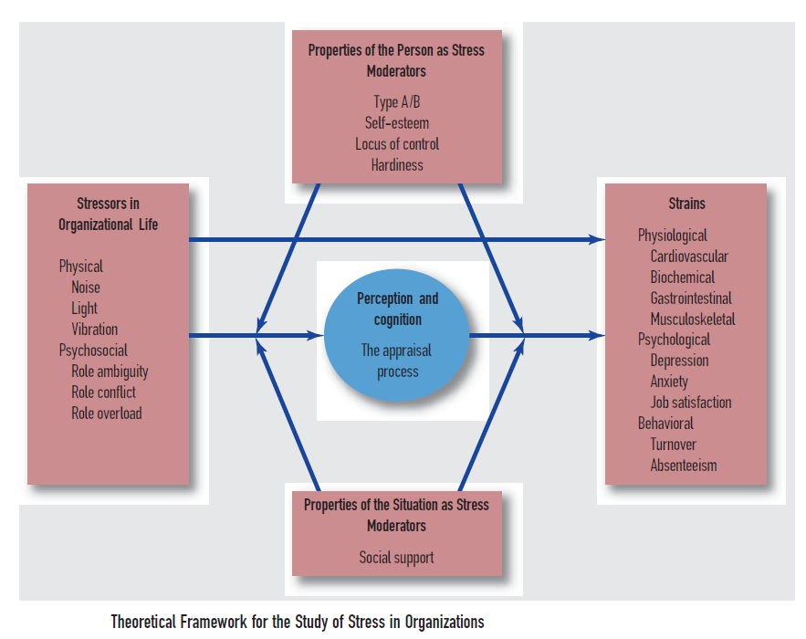

Slide 38
Type A behavior pattern (TABP) also known as coronary prone personality was first identified in the late 1950s by two cardiologists, Meyer Friedman and Ray Rosenman (1959) fifteen years later which they described the Type A behavior pattern as a set of characteristics exhibited by “individuals who are engaged in a relatively chronic struggle to obtain an unlimited number of poorly defined things from their environment in the shortest period of time and, if necessary, against the opposing effects of other things or persons in this same environment”. Individuals who exhibit this behavior pattern (known as Type As) are characterized by ambitiousness, impatience, easily aroused hostility, and time urgency. A core characteristic of TABP is an incessant struggle to achieve more and more in less and less time.
In contrast, Type Bs are often described as relaxed, patient, and easygoing.

Slide 39
Research on stress indicates that it involves, in addition to a physiological response consistent with Selye’s findings, a cognitive appraisal of the situation and of the resources available to handle the stressors. In their theory of stress, appraisal, and coping, Lazarus and Folkman (1984; Lazarus, 1991) viewed stress as an ongoing process in which individuals make an appraisal of the environment and attempt to cope with the stressors that arise. This appraisal often triggers a set of coping responses by the body. In some circumstances, such as during exercise, the process can be healthy. However, when exposure to stress is chronic or persistent, the body responds negatively. It is important to note that most of these reactions are automatic. They happen whether we want them to or not, almost as if we have an allergic reaction to a psychologically threatening or stressful environment. In fact, some of these physiological reactions to stress (e.g., high blood pressure) have no obvious physical symptoms.
Individuals appraise, experience, and cope with stressful situations in different ways and coping styles are typically divided into problem-focused and emotion-focused coping.

Slide 40
Stressors are physical or psychological demands to which an individual responds. Strains are reaction or response to stressors.
Problem-focused coping is directed at managing or altering the problem that is causing the stress. Such coping may include defining the problem, generating different solutions and weighing their costs and benefits, and acting to solve the problem (Lazarus, 2000). For example, problem-focused coping might involve developing and utilizing time management skills and designing a specific plan of action for handling a job with many demands.
Emotion Focused coping involves reducing the emotional response to the problem, which can mean avoiding, minimizing, and distancing oneself from the problem. For example, emotion-focused coping might involve obtaining social support from one’s family and friends to help minimize the effects of a stressful job.

Slide 41
Work stressors fall into two major categories: physical/task stressors, such as noise, light, heat, and cold, and psychological stressors, which involve a multitude of subtle and not so-subtle factors like lack of control or predictability and interpersonal conflicts, that an individual may find demanding. Work–family conflict is a situation that occurs when workers experience conflict between the roles they fulfill at work and in their personal lives.
Recent research has begun to differentiate between challenge-related and hindrance-related stressors. Challenge-related stressors are defined as work demands or circumstances that, although potentially stressful, offer potential gains (Boswell, Olson-Buchanan, & LePine, 2004). Examples of challenge-related stressors are the number of projects assigned, time spent at work, volume of work in a given time, and the amount and scope of responsibilities. Hindrance-related stressors are defined as job demands or circumstances that tend to limit or interfere with work achievement.

Slide 42
Consequences of stress
The negative consequences of chronic stress can be divided into three categories: behavioral, psychological, and physiological.
Behavioral Consequences of Stress
Among the behavioral consequences of stress are absenteeism, accidents, alcohol and drug abuse, poor job performance, and counterproductive behaviors including workplace violence. Stress has its effect on three particularly important behavioral outcomes: (1) information processing, which affects a variety of other critical work outcomes; (2) job performance, which can include information processing but often involves a global measure of effectiveness; and (3) counterproductive work behaviors.
Information Processing: Chronic stress has detrimental effects on memory, reaction times, accuracy, and performance of a variety of tasks (Smith, 1990). In addition, individuals under stress often have difficulty focusing their attention. Stress leads to premature reactions to stimuli, restricted use of relevant cues, and increased errors on cognitive tasks.

Slide 43
Performance: Arousal and performance have an inverted-U relationship. The inverted-U graph indicates that as arousal (or stress) increases, performance increases, but only up to a certain point; when arousal becomes too high, performance begins to decline. Thus, compared to situations with moderate arousal, both low levels of arousal (boredom) and high levels of arousal (extreme stress) result in lower performance. Alternatively, moderate arousal can lead to high motivation, energy, and attentiveness; this outcome is consistent with Selye’s concept of eustress, the “good stress”. It is important to note that stress represents only one of many factors that may affect job performance. Counterproductive Work Behavior: Spector and Fox (2005) developed a stressor–emotion model that linked stressors with counterproductive work behaviors. They proposed that stressors from the work environment increase perceptions of stress, which can then lead to negative emotions and, subsequently, counterproductive work behaviors.

Slide 44
Psychological Consequences of Stress
The psychological consequences of stress include anxiety, depression, burnout, fatigue, job tension, and dissatisfaction with one’s job and life (Kahn & Byosiere, 1992). Burnout is a particularly important and well-researched consequence of stress. It is an extreme state of psychological strain that results from a prolonged response to chronic job stressors that exceed an individual’s coping resources (Maslach, Schaufeli, & Leiter, 2001). Burnout was first observed in the caring professions: nursing, social work, and teaching.
Researchers have identified three components of burnout in these health care and human services settings: emotional exhaustion, feelings of depersonalization, and feelings of low personal accomplishment. Work settings with chronic, overwhelming demands and time pressures put workers at high risk for burnout. As such, interventions intended to reduce burnout should be focused on both the individual and the job. A combination of stress management, skills training, and job design seems to be the most promising avenue to prevent or reduce the development of burnout (van Dierendonck, Schaufeli, & Buunk, 2001).

Slide 45
Physiological Consequences of Stress
Physiological changes in the body occur when stressful situations cause overactivation of the sympathetic nervous system, which produces several different kinds of stress hormones. These stress hormones cause an increase in heart rate and cardiac output in preparation for increased physical and cognitive activity. Initially, these effects of stress can be beneficial in terms of improved decision making, judgment, and physical performance. However, chronic activation of the sympathetic nervous system leads to excess amounts of stress hormones circulating in the blood supply and the brain.
Stress also causes the blood vessels to shrink in the peripheral areas of the body (Eliot & Buell, 1983). The combination of shrinking blood vessels and more blood moving through them causes wear and tear on the coronary arteries and the heart. This leads to thickening of plaque in the arteries (atherosclerosis) and heart disease.

Slide 46
Theories of stress
Several theories of stress have been developed to organize the relationships among stressors, strains, and potential moderators of those relationships. Two theories that have received a great deal of attention are Karasek’s demand–control model and French’s person – environment fit model.
Demand - Control model
Karasek’s (1979) demand–control model suggests that two factors are prominent in producing job stress: job demands and job control (also known as decision latitude). In this model, job demands are defined according to two different criteria: workload and intellectual requirements of the job. Job control is defined as a combination of autonomy in the job and discretion for using different skills. Karasek proposed that the combination of high work demands and low control results in high-strain jobs that result in a variety of health problems. Food service worker, waitperson, nurse’s aide, assembly-line worker, and computer help-desk operator are considered high-strain jobs.

Slide 47
Food service worker, waitperson, nurse’s aide, assembly-line worker, and computer help-desk operator are considered high-strain jobs. Machine-paced jobs, in particular, are highlighted as having high demands and low control.
In contrast, jobs characterized by high demands that also provide sufficient control create an “active” job situation that is stimulating and health promoting. Active jobs include lawyer, engineer, manager, and physician. Jobs with low control and low demands (e.g., janitor, night watchman) are labeled as “passive” jobs.
Finally, jobs with high control and low demands (e.g., architect, dentist) are considered to be low-strain jobs. In a series of surveys involving U.S. and Swedish male workers, Karasek (1979) found that the combination of low control and heavy job demands correlated positively with mental strain (i.e., depression and exhaustion) and job dissatisfaction.

Slide 48
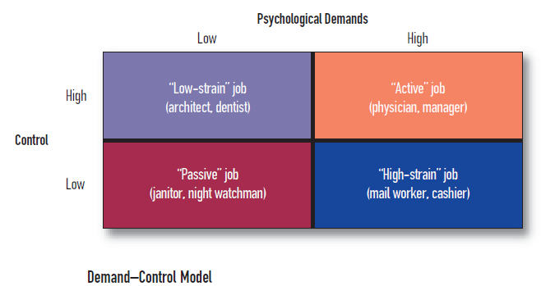

Slide 49
Person - Environment fit model
The person–environment (P–E) fit model (French, Caplan, & Harrison, 1982) hypothesizes that the fit between a person and the environment determines the amount of stress that person perceives. The environment makes demands and the person responds. A good person–environment fit occurs when a person’s skills and abilities match the requirements of the job and work environment. For example, an introvert with a PhD in literature would be likely to have a good P–E fit with the job of university librarian, while an extraverted MBA might have a good P–E fit with the job of sales manager. The amount of stress a worker feels is influenced by perceptions of the demands made by the environment and by perceptions of his or her capability to deal with those demands.
Using this model, French and colleagues (1982) found that a poor fit between a person and the environment was frequently associated with increased strains. Alternatively, employees whose skills and abilities fit well with the work environment reported less stress and fewer strains (Edwards, 1996). Shaw and Gupta (2004) found that the harmful effects of misfit are particularly severe for poorly performing employees, who suffer greater depression and physical health problems than high-performing employees.

Slide 50
Unlike the demand–control model, the P–E fit approach considers external influences such as social support from family and work sources. For example, Edwards and Rothbard (1999) found that the well-being of employees varied according to their perceptions of work and family experiences.
Early research did not always specify what “environment” was referred to in the P–E fit model. More recently, research has more clearly differentiated between person–job fit and person–organization fit (Lauver & Kristof-Brown, 2001). Person–job (P–J) fit refers to the extent to which the skills, abilities, and interests of an individual are compatible with the demands of the particular job. Alternatively, person–organization (P–O) fit refers to whether the values of an employee are consistent with the values held by most others in the organization.
The P–E fit model suggests mechanisms by which individuals can protect themselves from the stress that accompanies a mismatch between the person and the environment.

Slide 51
Reducing and managing stress
In 1990, stress was listed for the first time as one of the top 10 occupational health risks in the United States. As a result, concerns about stress at work became much more prominent in public and government discussions of health (Sauter, Murphy, & Hurrell, 1990). These concerns led to the development of the field of occupational health psychology, which involves the application of psychology to improving the quality of work life and to protecting and promoting the safety, health, and well-being of workers. The Handbook of Occupational Health Psychology provides a comprehensive source for a variety of occupational health psychology issues, including work–family balance, work design, and stress management interventions (Quick & Tetrick, 2010).
Occupational health psychology is the area of psychology that involves the application of psychology to improving the quality of work life and to protecting and promoting the safety, health, and well-being of workers.
Occupational health psychologists often divide their approaches to stress reduction and management into three major categories: primary, secondary, and tertiary interventions (Quick et al., 1997).

Slide 52
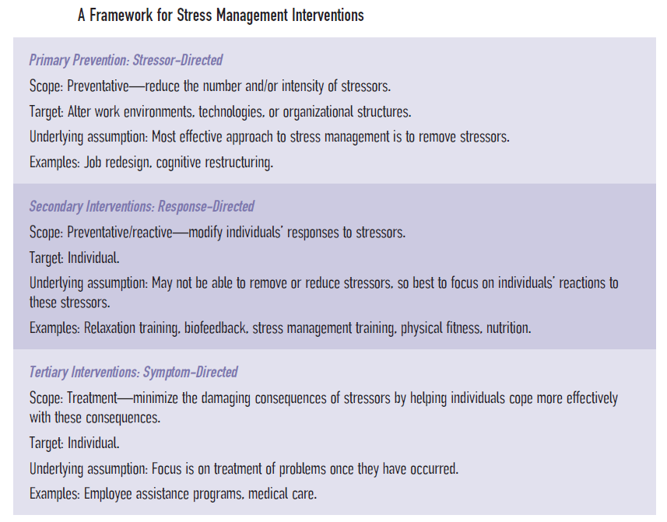

Slide 53
Primary prevention strategy is concerned with modifying or eliminating stressors in the work environment. Primary prevention approaches include redesigning the task or work environment, encouraging participative management, developing clearer role descriptions, and changing negative thoughts through cognitive restructuring. Another primary prevention strategy involves providing flexible work schedules, which can be seen in recent trends toward flextime, shorter workweeks, and job sharing.
Work Schedules
Work schedules are playing an increasingly important role in managing work–life balance in two ways: Individuals desire the freedom to pursue leisure activities outside of work, and they often have obligations to fulfill multiple roles as spouse, caregiver, and parent. This suggests that the scheduling of work can have substantial effects on stress and worker well-being. There are three different scheduling formats that bear discussion: shift work, flextime, and compressed workweeks.

Slide 54
Shift work is scheduling of work into temporal shifts; common in particular occupational groups such as nurses, blue-collar workers, and public safety personnel.
Circadian cycle is the 24-hour physiological cycle in which humans tend to be active during hours of light and inactive during hours of darkness.
Fixed shift is a particular shift that is permanently assigned to a worker.
Rotating shift is a shift that changes over a certain period of time.
Flextime is a schedule in which individual workers are given discretion over the time they report to work and the time they leave work on a given day.
Another nontraditional work schedule is the compressed workweek, which permits an employee to work for longer than eight hours a day and fewer than five days a week.

Slide 55
Secondary prevention strategies involve modifying responses to inevitable demands or stressors; thus, they are said to be response-directed. Because secondary prevention addresses the experience of stress rather than the stress or stressors, its role is often one of damage control. Thus, this type of intervention is often described as the “Band-Aid” approach (Cooper & Cartwright, 2001). Secondary prevention approaches are aligned with emotion-focused coping strategies, which seek to reduce the emotional response to the stressor and can involve avoiding, minimizing, and distancing oneself from the stressor (Lazarus, 2000). For example, emotion-focused coping might be used to reduce the stress experienced in a job that requires emotional labor.
Secondary prevention strategies that require no special training (but might be formally encouraged through an employer-sponsored program) include lifestyle choices such as physical fitness, healthy eating, and weight control, along with reductions in smoking and caffeine consumption. Skills training programs in such areas as negotiation and conflict resolution are another form of secondary intervention. In addition, secondary stress management methods include relaxation techniques, biofeedback, and providing or encouraging social support at work. Many approaches use combinations of the above methods

Slide 56
Tertiary prevention strategies are symptom-directed, that is, focused on healing the negative effects of stressors. Tertiary interventions include employee assistance programs and the use of medical care, individual psychotherapy, and career counseling (Quick et al., 1997).
Employee assistance programs (EAPs), originally developed by organizations to address alcohol and drug problems, were subsequently broadened to include stress management interventions. Organizations must ensure that confidentiality is maintained and that use of an EAP does not harm job security or advancement. These suggestions are particularly important because unhealthy work climates and distrust of EAPs often prevent employees from seeking help for alcohol or drug abuse problems.
even though focusing on the treatment of strains may be an effective short-term strategy, the approach is essentially reactive and recuperative rather than proactive and preventative.

Slide 57
Violence at work
In the past, the workplace was seen as a protected environment, one in which workers could feel safe. That is no longer the case (Barling, 1996). Violence is becoming more common in the workplace and therefore more important than ever to I-O psychologists (Bulatao & Vandenbos, 1996). Work-related violence falls into two different categories. The first deals with violent actions carried out by a nonemployee against an employee. Examples include armed robberies of convenience stores or gas stations in which a clerk is threatened, and often assaulted, by a robber. Similarly, workers in certain occupations, such as corrections and police officers, deal with violence as an essential function of their jobs. The second category of violence is perpetrated by employees and directed toward fellow employees. It is the second form of violence that we will consider. Several excellent reviews cover both types of violence (Kinney, 1995a,b; Vandenbos & Bulatao, 1996).

Slide 58
There have been many hypotheses about why we have seen the workplace become more violent since the early 1990s (Elliott & Jarrett, 1994; Mack, Shannon, Quick, & Quick, 1998), including the following:
● The surge of layoffs, mergers, and acquisitions has radically increased stress at the workplace.
● As a result of the large number of Baby Boomers in the workforce, fewer jobs are available as people strive to move up in the organization.
● Increasingly multicultural workplaces make it more likely that prejudices and biases will enter into worker interactions.
● There is a greater tendency for workers to abuse drugs and alcohol, thus lowering inhibitions that prevent violent behavior.
● In attempts to become leaner, organizations have eliminated layers of management, resulting in reduced opportunities for communication with employees about frustrating situations.

Slide 59
Understanding why certain individuals engage in workplace violence requires consideration of both their personal characteristics and stressful aspects of their work environment. Kinney (1995a, b) noted that stressful factors correlated with workplace violence include being passed over for an expected promotion, financial problems, estranged or strained relationships with co-workers, and a perception of being targeted by management. It is advisable that every organization have policies and plans in place to reduce work stress and workplace violence.
Most violent acts in the workplace are far less dramatic. They include such acts as verbal threats, insults, and bullying. There is a three-level description of the most common forms of workplace violence. Kinney (1995a,b) suggested that managerial and supervisory responses such as counseling, discipline, and referral to EAPs are often the most appropriate reactions to level 1 behaviors. More formal responses, often including psychological assessment and law enforcement involvement, might be required for level 2, and certainly for level 3, behaviors.

Slide 60
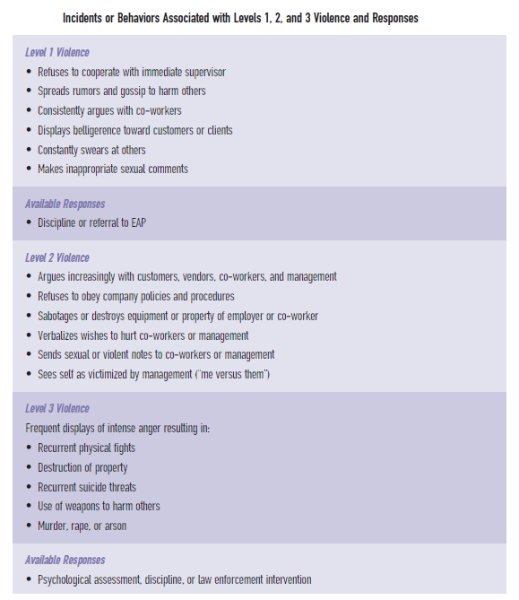

Slide 61
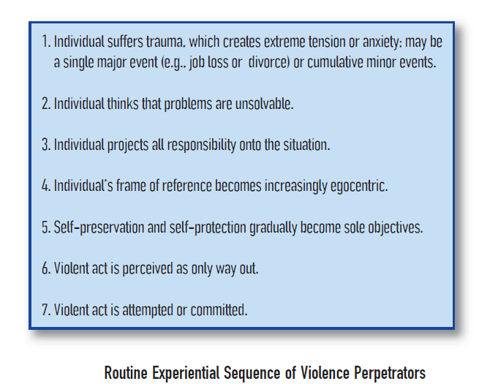
Kinney (1995a,b) outlined a common thought process that precedes the commission of a violent act in the workplace. The key steps in the sequence include an “event” in the individual’s life (e.g., a poor performance appraisal), a belief that a “problem” cannot be resolved, and a perceived threat to the individual’s self-esteem or wellbeing.

Slide 62
Theories of Workplace Violence
I-O psychologists commonly examine workplace violence using one of two theoretical approaches. The first is a variation on a traditional approach to all aggressive behavior, regardless of where it occurs. Its premise is that the individual worker has been frustrated—prevented from achieving some important goal or outcome—and this frustration results in aggression directed toward a co-worker or supervisor. The second approach is more specific to work situations and invokes the concept of justice.
Frustration–aggression hypothesis proposes that frustration leads to aggression; ultimately found to be too broad—aggression is only one possible response to frustration and not everyone responds to frustration with aggression.
Justice hypothesis of workplace violence hypothesis that some violent acts can be understood as reactions by an employee to perceived injustice.

Slide 63
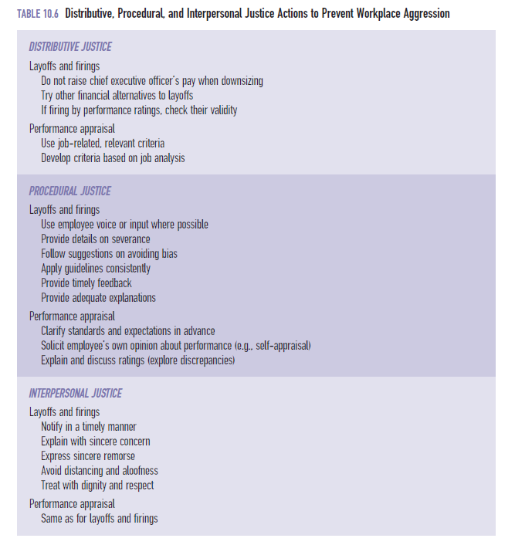

Slide 64
Fairness and diversity at workplace
The terms “justice,” “fairness,” and “trust” are often used interchangeably, and although they are closely related, they are still worth differentiating from one another. Justice and fairness are used to characterize an event or an exchange relationship. A worker will describe a pay increase as unfair, a company policy as unjust, or a supervisor as a fair person. Trust, on the other hand, is more an expectation than a reality. It is a belief about how a person or an organization will act on some future occasion based upon previous interactions with that person or organization (Ferrin, Dirks, & Shah, 2006).
Organizational justice is a type of justice that is composed of organizational procedures, outcomes, and interpersonal interactions.
A handbook devoted to the topic of organizational justice (Greenberg & Colquitt, 2005) covers both theory and research related to various types of organizational justice. Four types of justice have been suggested: distributive, procedural, interactional, and deontic.

Slide 65
Distributive justice concerns the perceived fairness of the allocation of outcomes or rewards to organizational members. There are many different definitions of what is “fair” in the distribution of rewards. One definition is based on merit. The people who work hardest or produce the most should get the greatest rewards. This is called the merit or equity norm. Another definition is based on the notion of equality: Every member gets the same share of rewards, regardless of effort. Finally, the definition of fairness can be based on the need norm: People receive rewards in proportion to their needs (Gilliland & Chan, 2001).
Distributive justice is about outcomes—who gets what. Procedural justice is about the process (or procedure) by which rewards are distributed. An important aspect of fair treatment is the ability to register objections. In labor–management contracts, this is covered by the concept of the grievance, or the right of an individual worker or group of workers to challenge an unfavorable action taken by the organization. In I-O psychology, this ability to challenge a process or outcome has been labeled voice (Folger & Cropanzano, 1998). The concept of voice means that the individual has the possibility of influencing a process or outcome.

Slide 66
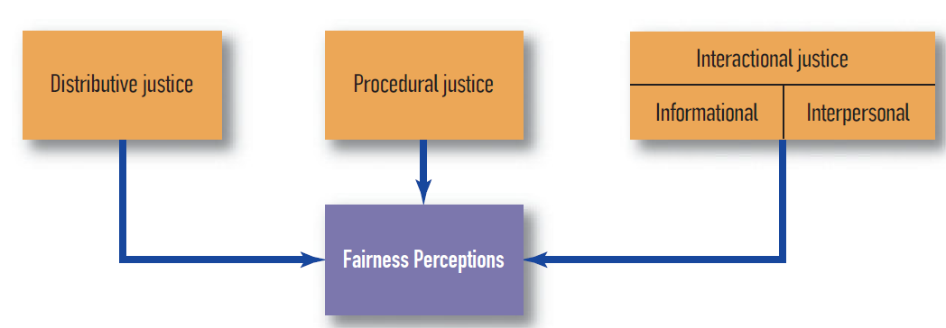
A third type of organizational justice is interactional justice, the sensitivity with which employees are treated (Bies & Moag, 1986). This concept deals with the extent to which an employee feels respected by the employer.
Cropanzano, Goldman, and Folger (2003; Folger, Cropanzano, & Goldman, 2005) have proposed an additional form of justice: deontic justice. The term “deontic” comes from philosophy and refers to moral responsibility or following moral rules.
Gilliland, Benson, and Schepers (1998) proposed that injustice has a much greater impact than justice on subsequent attitudes, emotions, and behavior.

Slide 67
Leadership
Virtually every employee in the 21st century will be called upon to display leadership behaviors at some point in time. We might think of this as “episodic” leadership—episodes of work life that require leadership behaviors. As an experienced department member, you might be called upon to fill in for a supervisor who is on vacation, or to lead a project team that has been formed for the purpose of dealing with a specific production problem, or even just to represent your peers in an informal discussion with your manager.
It is important to distinguish between the concepts of leader emergence and leadership effectiveness. Leader emergence is the study of the characteristics of individuals who become leaders, examining the basis on which they were elected, appointed, or simply accepted.
Leadership effectiveness is the study of which behaviors on the part of a designated leader (regardless of how that position was achieved) led to an outcome valued by the work group or organization.

Slide 68
we have taken a very positive view of leadership, assuming that a leader is trying to achieve positive outcomes using knowledge, skills, and abilities for the good of the organization. We often assume the leader seeks to do “good work.” But it is clear that some leaders are not interested in doing good work—or at least not doing work in a good way. These leaders are called destructive leaders, and they are beginning to receive more attention from researchers.
Einarsen, Aasland, and Skogstad (2007) define destructive leadership behavior as “the systematic and repeated behavior by a leader, supervisor, or manager that violates legitimate interest of the organization by undermining and/or sabotaging the organization’s goals, tasks, resources, and effectiveness and/or the motivation, well-being, or job satisfaction of his/her subordinates” (p. 207). Every organization seems to have one: the manager who verbally abuses subordinates in private with threats and shouts, who has a personal agenda of self-promotion that is different from the stated goals of the group or organization, who drives people out of the department or unit, or who seems immune to any attempt to change his or her style.

Slide 69
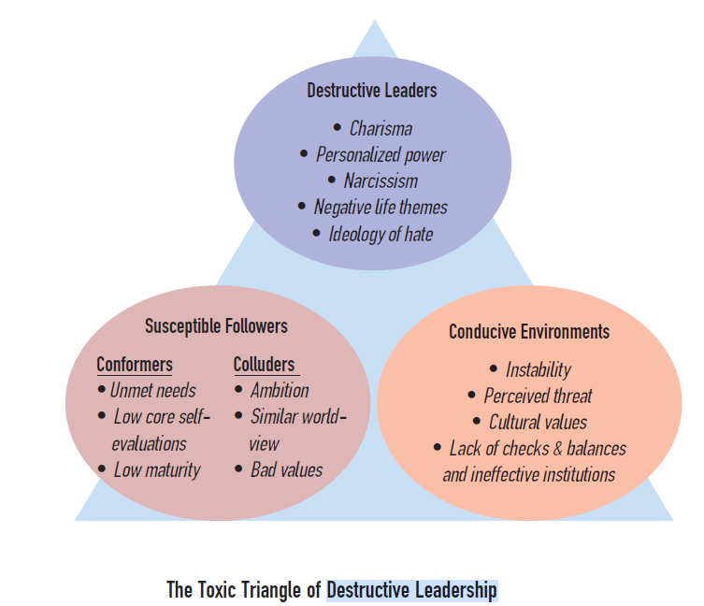

Slide 70
Einarsen and colleagues (2007) describe the following three types of destructive leaders.
Tyrannical - The tyrannical leader may accept the goals of the organization but seeks to achieve those goals through actively manipulating and humiliating subordinates. The fact that the tyrannical leader often does accomplish organization goals may result in very different evaluations of his or her effectiveness. Upper management views the leader favorably, while subordinates see only a bully.
Derailed - Like the tyrannical leader, the derailed leader behaves abusively—but he or she also engages in anti-organizational behaviors such as laziness, fraud, and theft. Derailed leaders are often characterized as leaders who have hit a substantial pothole on their road to success.
Supportive-Disloyal - Unlike the first two types of destructive leaders, the supportive-disloyal leader actually shows consideration for subordinates but violates the goals of the organization by undermining goal accomplishment. This undermining may result from stealing resources from the organization, granting subordinates excessive benefits, or encouraging loafing or misconduct by subordinates.

Slide 71
Leader is the individual in a group given the task of directing task-relevant group activities or, in the absence of a designated leader, carrying the primary responsibility for performing these functions in the group. With such a neutral definition, “leader” could be replaced with the words “director,” “manager,” “supervisor,” or even “coordinator.” A leader is someone who influences, or attempts to influence, other people. The behaviors involved in exerting this influence can be called leadership, and those who exert such influence can be called leaders. But attempts at leadership are not always successful. Bass (1960) made the following distinctions:
● Attempted leadership. Person A accepts the goal of changing person B and can be observed attempting to do so.
● Successful leadership. Person B changes his or her behavior as a function of person A’s effort.
● Effective leadership. As a function of person B’s behavioral change resulting from person A’s efforts, person B will be more satisfied, will be better rewarded, and will have attained a goal of mutual importance to person A and person B.

Slide 72
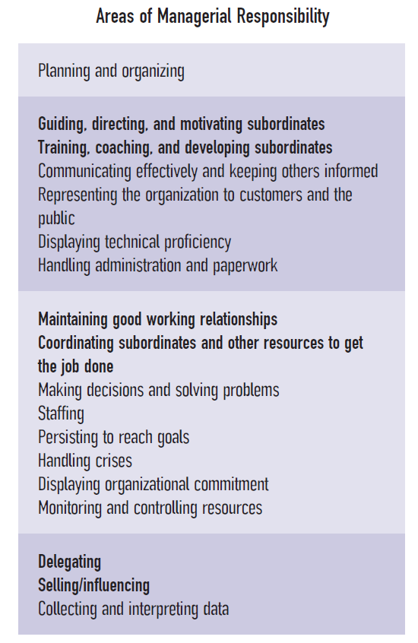

Slide 73
Leader development is a process that concentrates on developing, maintaining, or enhancing individual leader attributes such as knowledge, skills, and abilities and leadership development is a process that concentrates on the leader–follower relationship and on developing an environment in which the leader can build relationships that enhance cooperation and resource exchange.
The single most important “ability” for creating leadership opportunities is the interpersonal competence of the person designated as the leader which is a type of competence that includes social awareness and social skills, such as the ability to resolve conflict and foster a spirit of cooperation.
According to McClelland (1985), people learn that the exercise of power, or control, over others or the environment is pleasing: the power motive.

Slide 74
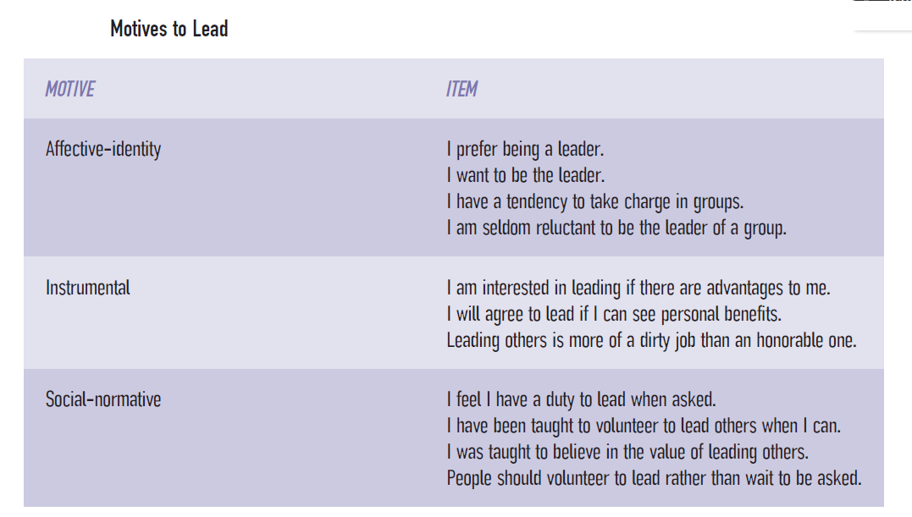

Slide 75
High activity inhibition is the psychological term used to describe a person who is not impulsive. A low affiliation need means that a person does not have a great desire for approval or connections with others. According to House and Singh (1987), a low affiliation need permits an individual “to remain socially distant from subordinates and therefore to be more objective with respect to resource allocation, delegation, and discipline”.
People who aspire to positions of leadership have a high power motive coupled with high activity inhibition and low affiliation needs. Additional research suggests a combination of personality characteristics, beliefs about leadership capability, and past leadership experiences as motives for leadership.

Slide 76
Traditional theories of leadership
Most of the leadership theories are “Great man” theories, leadership theories developed by historians who examined the life of a respected leader for clues leading to that person’s greatness; Two kinds of sources of leader greatness are popular: (1) a galvanizing experience, such as overcoming a near-fatal illness, or (2) an admirable trait, such as persistence, optimism, or intelligence, that the leader possesses to a singular degree.
Trait approach
Leadership theory that attempted to show that leaders possessed certain characteristics that nonleaders did not. It was, in simple terms, an attempt to show that leaders possess certain characteristics that nonleaders do not. The trait approach proved to be a dead end. No consistent relationships were found between traits and leadership effectiveness, in part because there was little agreement about what these traits even meant.

Slide 77
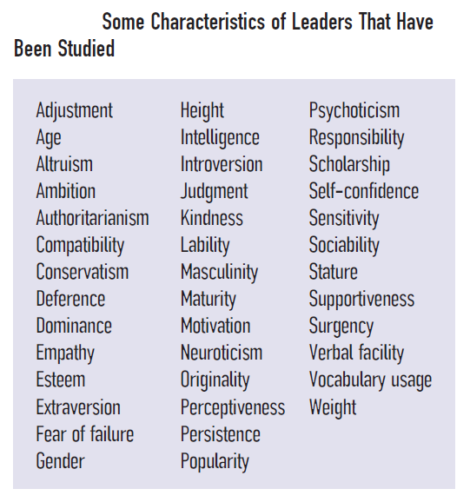

Slide 78
The Power Approach to Leadership
One of the most obvious characteristics of managers is that they have power that subordinates do not have. An organization gives a manager the power to make decisions about people, expenses, methods of production, and so forth. The higher the manager is in the organization, the more power, or authority, he or she tends to have. This is the power approach to leadership that examines the types of power wielded by leaders. French and Raven (1959) suggested at least five different types of power, including the following:
● Reward power. The potential of a supervisor to dispense valued rewards
● Coercive power. The potential of a supervisor to dispense punishments
● Legitimate power. The “right” of a supervisor to influence a subordinate and the obligation of the subordinate to accept that influence
● Referent power. The identification of the subordinate with the supervisor; the desire of the subordinate to be like and act like the supervisor; the power of example
● Expert power. The knowledge or expertise that a supervisor has in a special area

Slide 79
Managers use their formal power or authority to increase other power bases (Yukl, 1998). They use methods such as the following:
● Forming coalitions (e.g., managers from different departments joining forces; a marketing manager forming an alliance with a supplier)
● Controlling important decisions (e.g., attempting to get sympathetic representatives appointed to decision-making groups)
● Co-opting the opposition (e.g., inviting a strong opponent to join a committee or decision-making body)
● Controlling information flow (e.g., limiting the distribution of information about bad decisions that the manager made and maximizing the distribution of information about good decisions)

Slide 80
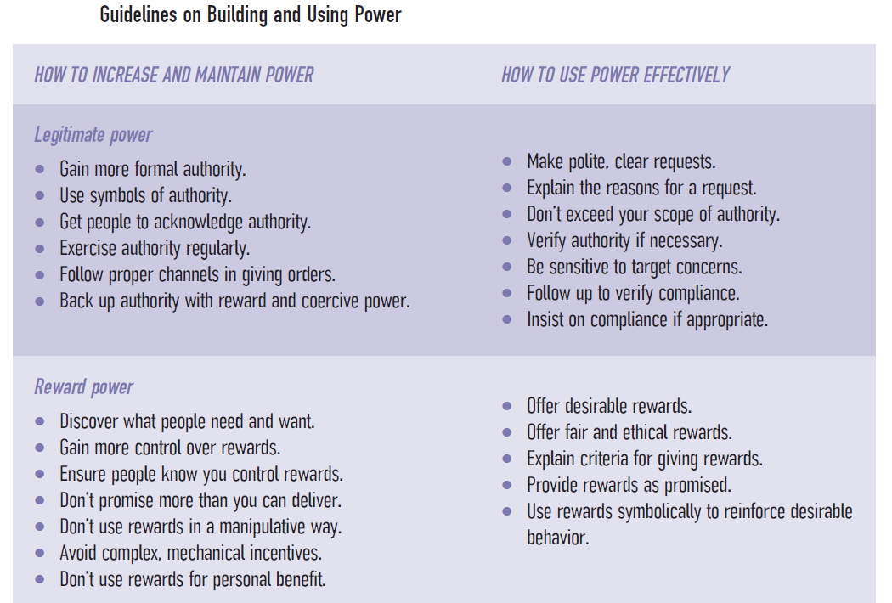
The Behavioral Approach
Behavioral approach was begun by researchers at Ohio State University, leadership theory that focused on the kinds of behavior engaged in by people in leadership roles and identified two major types: consideration and initiating structure.

Slide 81
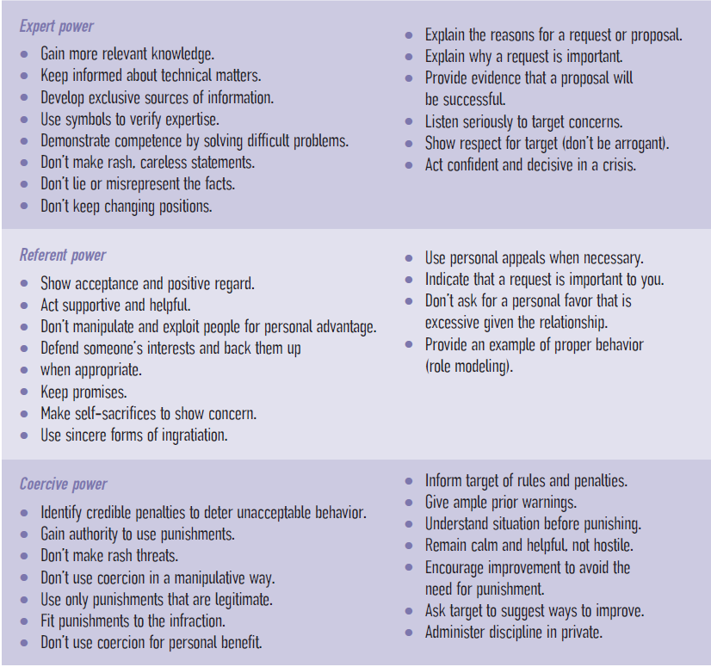

Slide 82
These two dimensions were defined as follows:
Consideration: Includes behavior indicating mutual trust, respect, and a certain warmth and rapport between the supervisor and his group. . . . This dimension seems to emphasize a . . . concern for group members’ needs and includes such behavior as allowing subordinates more participation in decision making and encouraging more two-way communication.
Initiating structure: Includes behavior in which the supervisor organizes and defines group activities and his relation to the group. Thus, he defines the role he expects each member to assume, assigns tasks, plans ahead, establishes ways of getting things done, and pushes for production. This dimension seems to emphasize overt attempts to achieve organizational goals. (Fleishman, E. A., & Harris, E. F. (1962). Patterns of leadership behavior related to employee grievances and turnover. Personnel Psychology, 15, 43–56. Reprinted by permission of John Wiley & Sons, Inc.)

Slide 83
The University of Michigan Studies
At around the same time as the Ohio State leadership studies, researchers at the University of Michigan also became interested in leadership behavior, but they concentrated more on the dynamics of how leaders and groups interacted (Yukl, 2006). Like the Ohio State studies, the Michigan group identified task-oriented behavior (initiating structure) as an important part of a leader’s activities. They also found that relations-oriented behavior (similar to consideration in the Ohio State model) was important. What was different about the Michigan results was that participative behavior on the part of a leader was a key to group effectiveness.
The Contingency Approach
Leadership theory proposed to take into account the role of the situation in the exercise of leadership.

Slide 84
Hersey and Blanchard (1977) proposed that the success of various leadership approaches depended in part on the maturity of the subordinate. Maturity had two different facets to it. Job maturity was defined by the subordinate’s job-related ability, skills, and knowledge. Psychological maturity was defined as the self-confidence and self-respect of the subordinate (Yukl, 2006). A subordinate characterized as high in maturity would have both ability and confidence.
House and his colleagues (House, 1971; House & Mitchell, 1974) suggested a contingency theory approach that has been called the path–goal theory because it assumes that the leader’s responsibility is to show the subordinate the path to valued subordinate goals.
The Consequences of Participation: The Vroom–Yetton Model
Both the Michigan and the path–goal models identified a participative leadership style. Participative behaviors on the part of the leader were also implied in the Ohio State and Hersey and Blanchard models.

Slide 85
This model makes a practical contribution to leadership. The Vroom–Yetton model assumes that one of the most important duties of a leader is to make decisions, and it suggests a way to choose a decision-making strategy. Equally important, is the implication that group decision making or a completely participative style is not always appropriate. Although a participative style might contribute to the satisfaction of group members, it might lead to a poorer decision.

Slide 86
New approaches to Leadership
Most leadership theories, implicitly if not explicitly, assume that leaders treat all followers similarly. Dansereau, Graen, and Haga (1975) suggested that this approach was overly simplistic. In their leader–member exchange (LMX) theory, they hypothesized that leaders adopt different behaviors with individual subordinates and that the particular behavior pattern of the leader develops over time and depends, to a large extent, on the quality of the leader–subordinate relationship. Subordinates fall into two distinct groups. In-group members have high-quality relationships with their leader and high latitude for negotiating their work roles; the leader tends to deal with in-group members without resorting to the use of formal power or authority. In contrast, out-group members have low-quality relationships with their leader and little latitude for negotiating their work roles; the leader is more likely to rely on formal power and authority to influence their behavior.
Compared with out-group members, in-group members were more likely to remain with an organization, tended to see themselves as involved in a valuable exchange of knowledge, as receiving logistic and emotional support from their leader, and as expending extra effort on behalf of their leader. In high quality relationship exchanges, leaders discussed performance with subordinates, initiated discussions about personal matters and problems, and appeared genuinely interested in work-related difficulties.

Slide 87
Low-quality relationships of out-group members were characterized by higher turnover and the tendency to view the exchange with their leader as nothing more than a contractual agreement in which the worker contributes “eight hours’ work for eight hours’ pay.” In low-quality relationships, leaders seldom talked to subordinates about effectiveness or helped them with difficult assignments.
More recent revisions of LMX theory are more dynamic and describe a life cycle of a leader–follower relationship, which begins tentatively and then either evolves into a more trusting and committed relationship or remains fixed at the initial stage.
There is general agreement that LMX theory “works” (i.e., that high-quality LMX relationships lead to improved employee attitudes, motivation, and performance). As an example, Ilies, Nahrgang, and Morgeson (2007) found a strong and positive relationship between LMX and organizational citizenship behaviors.

Slide 88
LMX theory is an appealing approach to leadership because it acknowledges that differential relationships exist between leaders and followers, and this fits with what most of us have experienced in work settings. Now that researchers are concentrating on why LMX theory works rather than simply demonstrating that it works, great progress is being made. It is also particularly encouraging to see the increasingly cross-cultural character of this research.
Transformational Leadership
Transformational leadership is the interplay between leaders and followers in which each raises the other to higher levels of ethics, morality, and motivation. The leader transforms the followers by appealing to their nobler motives, such as justice and peace. We have seen this capacity to transform followers in great leaders such as Martin Luther King, Jr., Mahatma Gandhi, and Archbishop Desmond Tutu. By articulating a vision of a better world and demonstrating through their own actions how to achieve that better world, leaders of this caliber persuade followers to believe that they as individuals can make a difference, to forget about pursuing their own concrete rewards, and to join in the effort to achieve that better world—in short, the leader makes them want to be better than they are.

Slide 89
Burns (1978) contrasted transformational leadership with transactional leadership, the more traditional process by which leaders show followers how they can meet their personal goals by adopting a particular behavior pattern. The transactional leader makes it clear to the followers what behaviors on their part will be rewarded. Followers can then adopt that behavior pattern if they wish to achieve the promised rewards. A leader who develops an incentive program in which employees are rewarded for increased production is acting as a transactional leader. Bass and Avolio (1997) have used Burns’s notion of transformational leadership to describe the behavior of corporate leaders rather than political leaders.
Bass and Avolio (1997) proposed that transformational leaders typically use one of four general strategies.
1. Idealized influence. Leaders display conviction, emphasize trust, take stands on difficult issues, emphasize the importance of commitment and purpose, and are aware of the ethical consequences of their decisions.

Slide 90
2. Inspirational motivation. Leaders articulate an appealing vision of the future, challenge followers with high standards, talk optimistically with enthusiasm, and provide encouragement and meaning for what needs to be done.
3. Intellectual stimulation. Leaders question old assumptions, values, and beliefs; stimulate new ways of doing things; and encourage expression of ideas and reasons.
4. Individualized consideration. Leaders deal with others as individuals; consider individual needs, abilities, and aspirations; listen attentively; and advise, coach, and teach.
Instead of seeing the styles as mutually exclusive, Bass (1997) perceived transformational leadership as building upon transactional leadership in a hierarchy with respect to their effectiveness. The lowest level is identified as laissez-faire leadership, in which leaders provide little guidance to their followers. Although some managers might mistakenly consider this a “leadership style,” Bass did not agree.

Slide 91
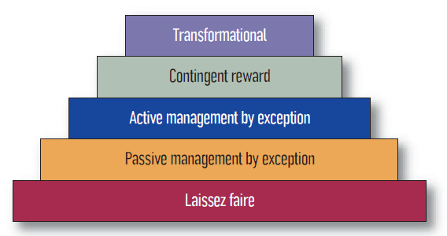
He included it in the hierarchy to contrast it with legitimate leadership styles—transactional and transformational. The three levels of transactional leadership are arranged in order of effectiveness; the transformational style (at the top) is the most effective, but it includes and builds upon transactional behaviors, particularly contingent rewards.

Slide 92
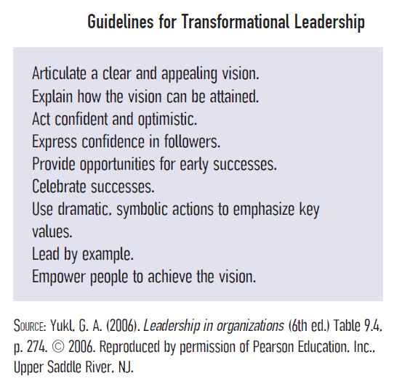

Slide 93
Authentic leadership
It is a style of leadership that emphasizes the genuineness and integrity of the leader, usually accompanied by a life story.
Eagly (2005) worries that women will have a greater struggle projecting authenticity than men because of negative stereotypes of women as leaders. Further, she is concerned that women will actually suffer if they do reveal their real selves, since their real selves (e.g., nurturing, process oriented, egalitarian) may not be compatible with male stereotypes of leaders. There is also the obvious difficulty of relating “war stories” of past leadership challenges and successes to followers when you have been permitted few of those leadership opportunities as a woman.
Walumbwa, Avolio, Gardner, Wernsing, and Peterson (2008) have introduced a scale to measure authentic leadership style known as the Authentic Leadership Questionnaire (ALQ). Several studies indicate that authentic leadership was associated with higher performance and organizational citizenship behaviors in followers

Slide 94
The Charismatic Leader
One of the transformational strategies identified by Bass was labeled idealized influence, which he also called charisma. Charisma is a personal magnetism, compelling charm, or attractiveness that inspires admiration and compliance from others. Charismatic leader is the one to whom the followers are emotionally attached to, never question the leader’s beliefs or actions, and see themselves as integral to the accomplishment of the leader’s goals.
Charismatic leadership theory is the approach to leadership theory with many different versions of the notion that charisma is related to leadership; in one version, in a crisis situation, followers perceive charismatic characteristics in an individual and accept that person as a leader; in another version, certain leader behaviors (use of innovative strategies) contribute to a charismatic aura.

Slide 95
Leadership in a Changing Workplace
Knowledge-Oriented Organizations
Uhl-Bien, Marion, and McKelvey (2007) note that historical models of leadership, particularly those that are top-down and bureaucratic, are best suited for a 20th-century economy, where physical production was essential, but are ill suited for the 21st-century workplace, which is best characterized as knowledge-oriented. Furthermore, they propose that one of the key characteristics of the 21st-century organization is the need to adapt and learn. Thus, theories of leadership effectiveness must include outcomes such as organizational learning, innovation, and adaptability rather than focusing on bureaucratic and administrative functions of the leader.
Teams/Groups
Groups and teams are increasingly populating today’s workplace. There are fewer and fewer single contributors.

Slide 96
Many of the traditional leadership models are focused on the relationship between a single leader and a single follower. Things are a bit more complicated now. Certainly, individual interactions between a worker and a manager still take place, but there are also interactions between managers and teams/groups. It is no longer sufficient for a leader to concentrate on influencing individual work group members one by one. The team or group is a separate entity and must be considered independent of its members.
As if teams were not challenging enough, there is also the issue of virtual teams. A virtual team consists of geographically or organizationally dispersed members brought together through “a combination of telecommunications and information technologies to accomplish an organizational task” (Townsend, DeMarie, & Hendrickson, 1998, p. 17). As Bell and Kozlowski (2002b) pointed out, virtual teams present novel challenges for a leader, including the socialization of new team members and monitoring of the progress of the teams as they go about their work.

Slide 97
Telecommuting
An increasing number of employees telecommute (i.e., work from home part or all of the workweek). As with virtual teams, telecommuting presents monitoring and communication challenges for a leader. Telecommuting comes in many different forms (Adams, 2001). Most common is the home office, a manager may be faced with a very basic issue: tracking an employee down on a given day.
Temporary Workers
As organizations become “leaner,” they are more likely to make use of temporary workers. Often an organization uncertain of long-term business prospects will fill vacant positions with consultants or contract workers. The advantage of hiring temporary workers is that it allows an organization to respond to market changes by quickly increasing or decreasing the workforce. From a leader’s perspective, however, temporary workers represent a challenge. As temps are unlikely to have the same commitment or share the same values as full-time employees, they may be more difficult to motivate. In addition, these workers may be expected to support work groups and teams without being a member of any particular team.

Slide 98
Current trends in Positive Psychology at workplace
Positive psychology in the workplace is an approach and method focused on building on what is working well and strengthening that, rather than focusing on “fixing” what is not working. In a workplace context, it’s an approach that can be applied to individuals, groups, and whole organisations.
Positive psychology is an area of psychology focusing on helping people build happy, meaningful, purposeful lives. Implementing positive psychology in the workplace is about building a positive and healthy work environment that is enjoyable, productive, and engaging. When positive psychology is applied in a workplace, it can be a powerful tool to help people thrive and perform at their best. The studies of positive psychology at work have grown into a whole field of research, often talked about under the umbrella term Positive Work and Organizations (PWO).

Slide 99
This is an area that encourages the cross-pollination of three research streams in positive psychology in the workplace:
Positive Organisational Psychology (POP) is “the scientific study of positive subjective experiences and traits in the workplace and positive organisations, and its application to improve the effectiveness and quality of life in organisations”, according to Donaldson and Ko. This is an approach that differs from traditional organisational behavior modification methods, in that it aims to develop and emphasize positive behaviours in organizations rather than prevent harmful ones.
Positive Organisational Behavior (POB) is an area of research that examines psychological capabilities that can be developed and measures, such as optimism, hope, self-efficacy, and resilience – both at the individual and team levels.
Positive Organisational Scholarship (POS) is defined as the study of that which is positive, flourishing and life giving in organizations. This field of research is focusing on positive processes and outcomes for organisations and their employees in, for example, areas like organisational virtuousness, positive deviance, and appreciation cultures.

